Slide 1

Fantasy League Legend
Bolin Zhu
Notes:
我之所以选择这个课题是因为我对篮球感兴趣，同时我也喜欢玩篮球游戏

Slide 2
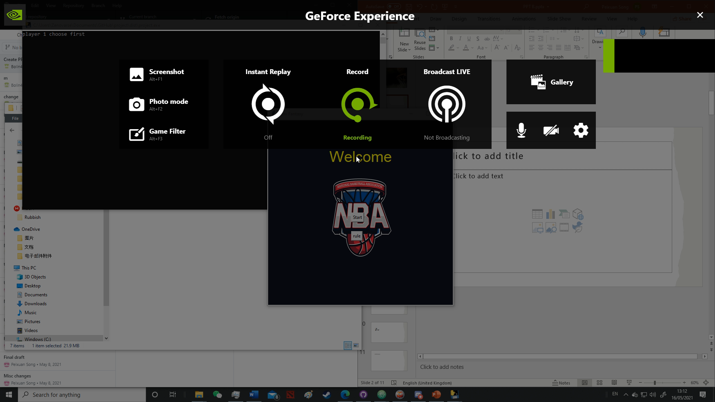

Slide 3
Introduction
This project presents a team scoring system that I have created in the form of a game. Unlike many other systems, this one considers the chemistry between players.
Team chemistry is a value that reflects how well the players work with each other and their relationships.
The project will use two main algorithms, strength and team chemistry, to calculate team scores and be presented as a card game.

Slide 4
gamr
calculations
team
str
ui

Slide 5
Binary relationship graph model
Advantage: Easy to implement
Disadvantage: Does not model group information E.g. chemistry of 3 players.
Models individual strengths and the chemistry between two people.
1
4
3
2
5

Slide 6
Group relationship model
Models the strength of subsets of players

Slide 7
Normalization

Slide 8
Team chemistry
Team elo normalized to follow the same distribution as the player per
Taking away the strength of the rest of the team to estimate the strength of the group

Slide 9
-
=

Slide 10
ELO
什么是elo
Why you use it
Notes:
最先开始使用的，结合2krating，但由于2krating的数据不确定可靠性，所以后面将2krating换成了per

Slide 11
PER
什么是per
Why you use it
Notes:
由于eloz只能展示队伍的强度，所以结合使用了per（可以展现个人），

Slide 12
Calculation
最终决定的数值
加入化学值的计算

Slide 13
软件制作
方法（加图片）
代码图片+图片（帮助理解）

Slide 14
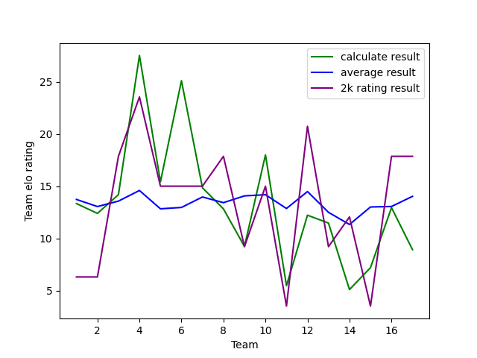

Slide 15
样本
最终结果图

Slide 16
reference

